Slide 1
Neural Networks for Time Series Data
UIUC ECON 490: Applied Machine Learning in Economics

Slide 2
Time Series Data
The weather tomorrow will be similar to today

Slide 3
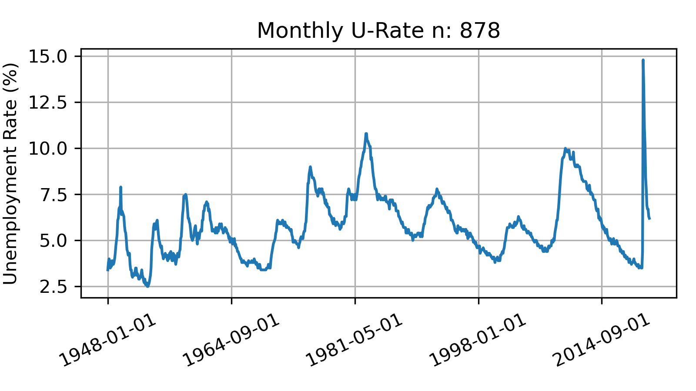
Time Series: Today is like yesterday (in general)

Slide 4
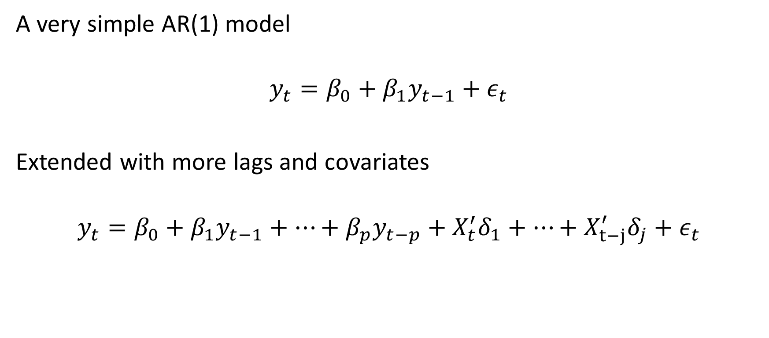
Basic Intuition – autoregressive model
A very simple AR(1) model
$$y_{t}=β_{0}+β_{1}y_{t−1}+ε_{t}$$
Extended with more lags and covariates
$$y_{t}=β_{0}+β_{1}y_{t−1}+…+β_{p}y_{t−p}+X_{t}^{′}δ_{1}+…+X_{t−j}^{′}δ_{j}+ε_{t}$$

Slide 5
Content for today
Recurrent neural networks (RNN)
NN designed for time series
Long-short term model (LSTM) – encoding memory
Convolution neural networks (CNN)
Originally intended for images
Can be adjusted for time series
Another conversation about data
Finding economic data into NNs is challenging
No code today. See textbook, Keras examples, and other online sources.

Slide 6
Recurrent Neural Network
Outputs are inputs: not a feed-forward system

Slide 7
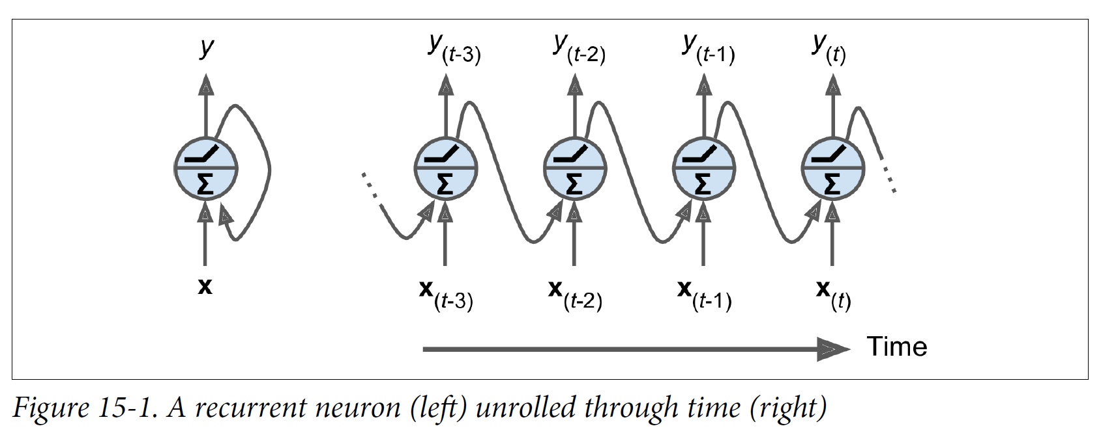
RNN with one neuron – a similar idea

Slide 8
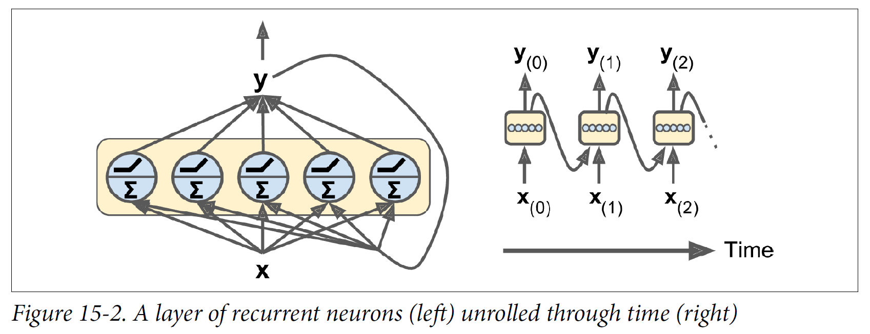
We can replace the neuron with a layer

Slide 9
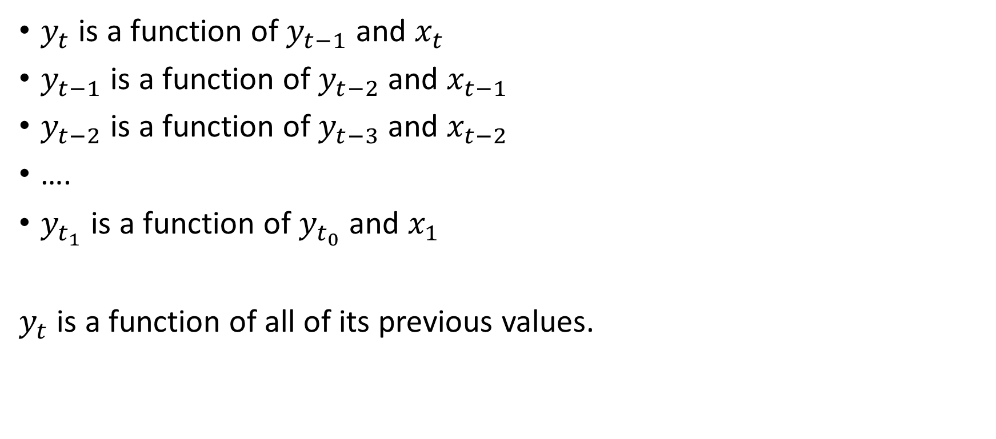
Today depends on yesterday is embedded in RNN
$y_{t}$ is a function of $y_{t−1}$ and $x_{t}$
$y_{t−1}$ is a function of $y_{t−2}$ and $x_{t−1}$
$y_{t−2}$ is a function of $y_{t−3}$ and $x_{t−2}$
….
$y_{t_{1}}$ is a function of $y_{t_{0}}$ and $x_{1}$
$y_{t}$ is a function of all of its previous values.

Slide 10
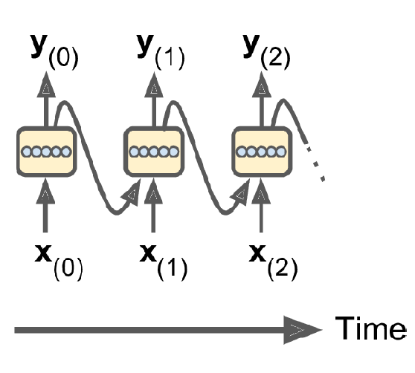
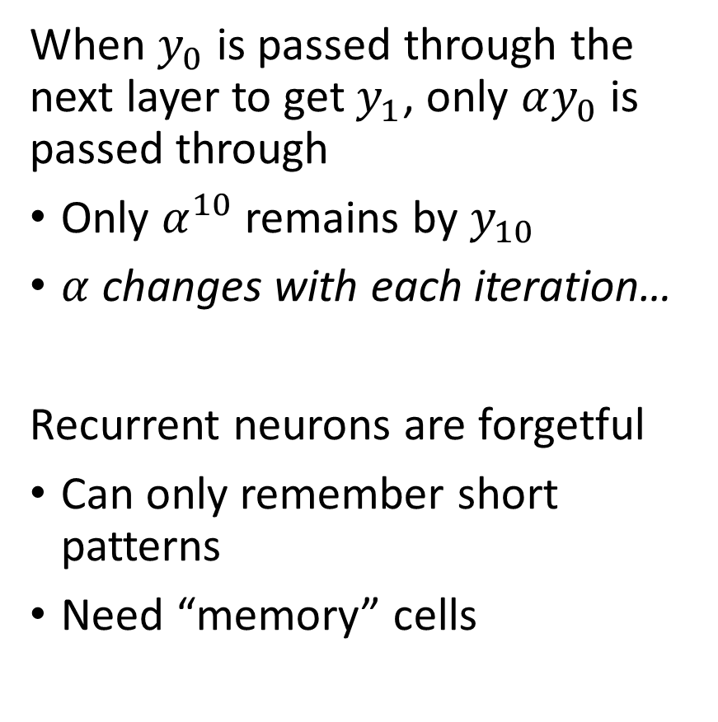
Only a portion of $y$is passed to the next layer
When $y_{0}$ is passed through the next layer to get $y_{1}$, only $αy_{0}$ is passed through
Only $α^{10}$ remains by $y_{10}$
$α$ changes with each iteration…
Recurrent neurons are forgetful
Can only remember short patterns
Need “memory” cells

Slide 11
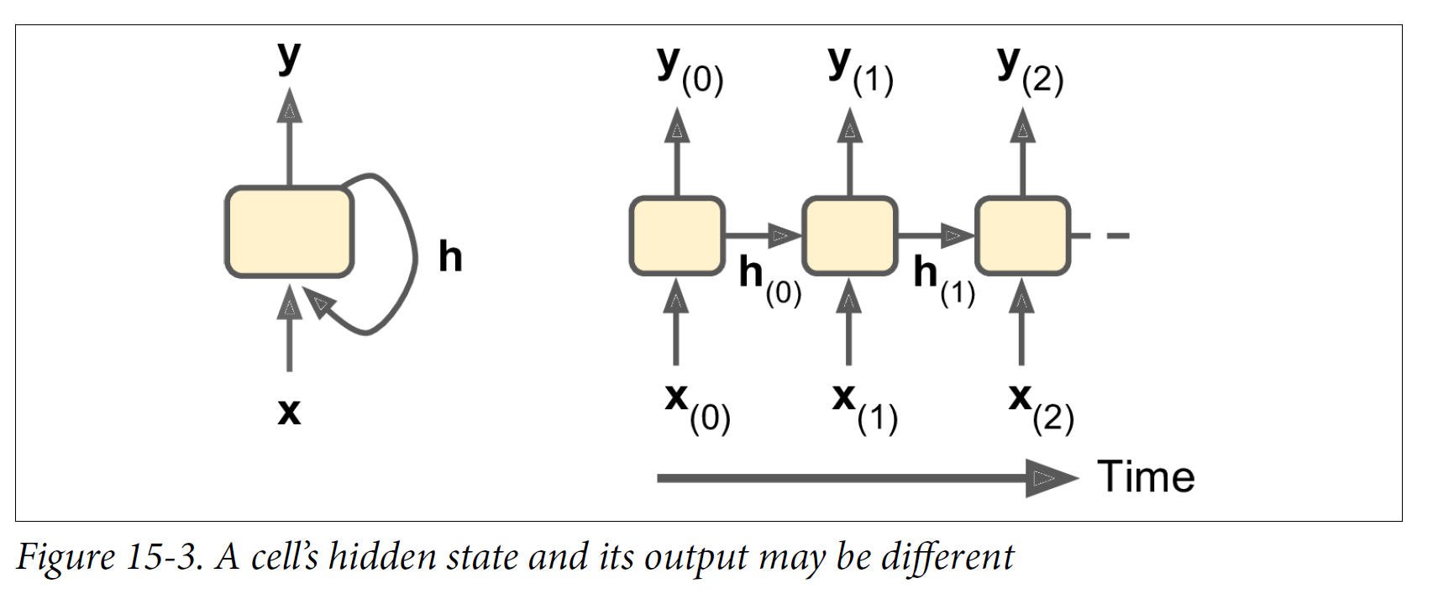
RNNs can output separate predictions and states

Slide 12
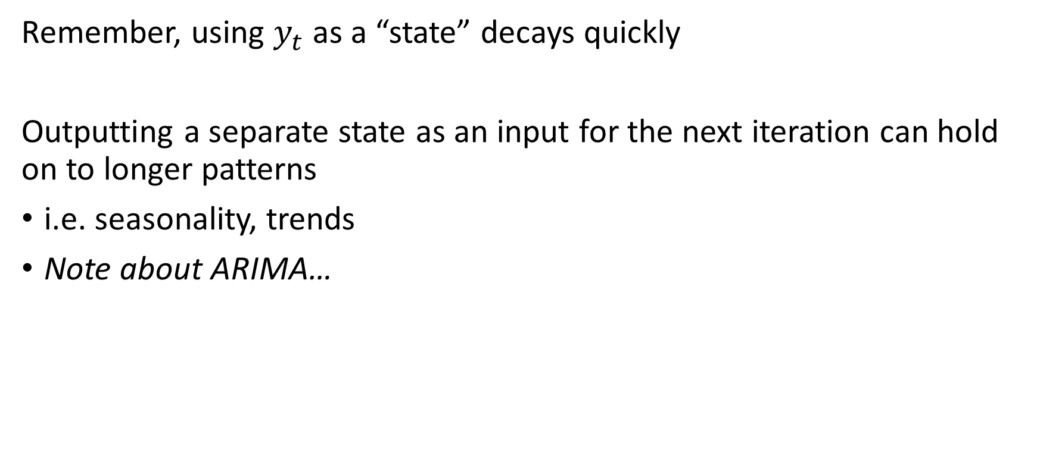
Separate state outputs help long-term memory
Remember, using $y_{t}$ as a “state” decays quickly
Outputting a separate state as an input for the next iteration can hold on to longer patterns
i.e. seasonality, trends
Note about ARIMA…

Slide 13
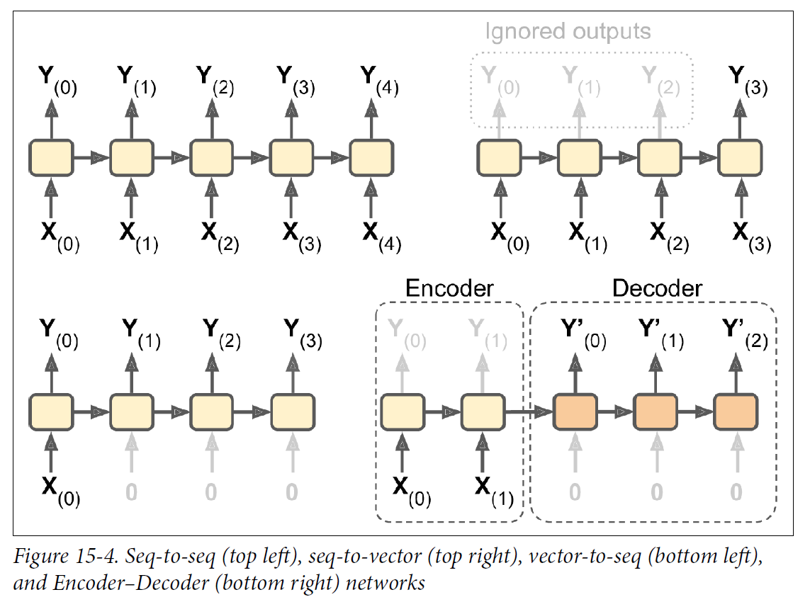
RNN Memory Cell Architectures

Slide 14
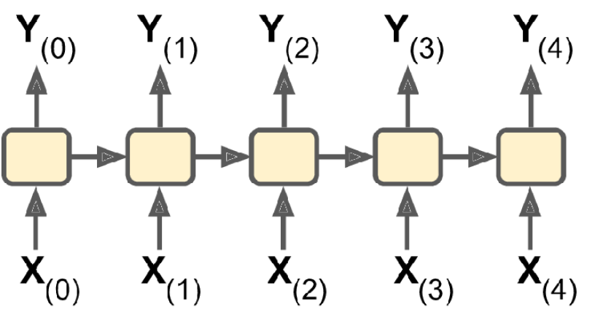
Sequence-to-sequence
Shift input sequence by one period (or more)
Useful for financial data

Slide 15
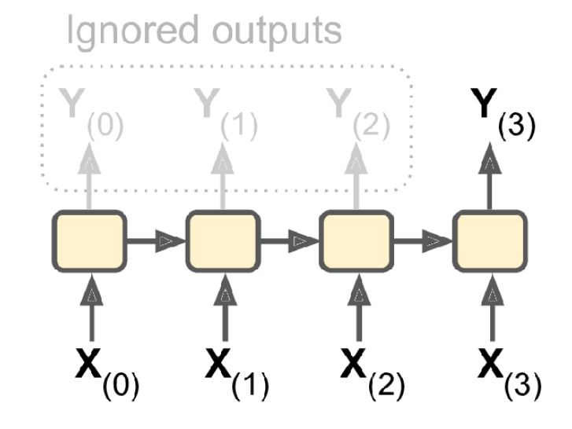
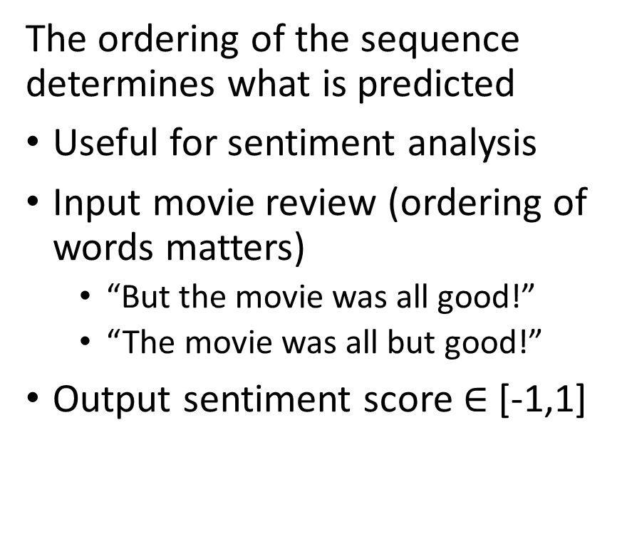
Sequence-to-vector
The ordering of the sequence determines what is predicted
Useful for sentiment analysis
Input movie review (ordering of words matters)
“But the movie was all good!”
“The movie was all but good!”
Output sentiment score $∈$ [-1,1]

Slide 16
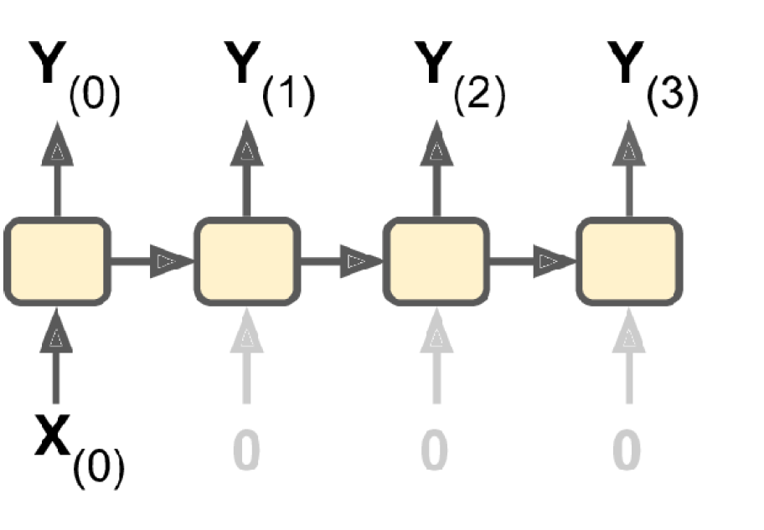
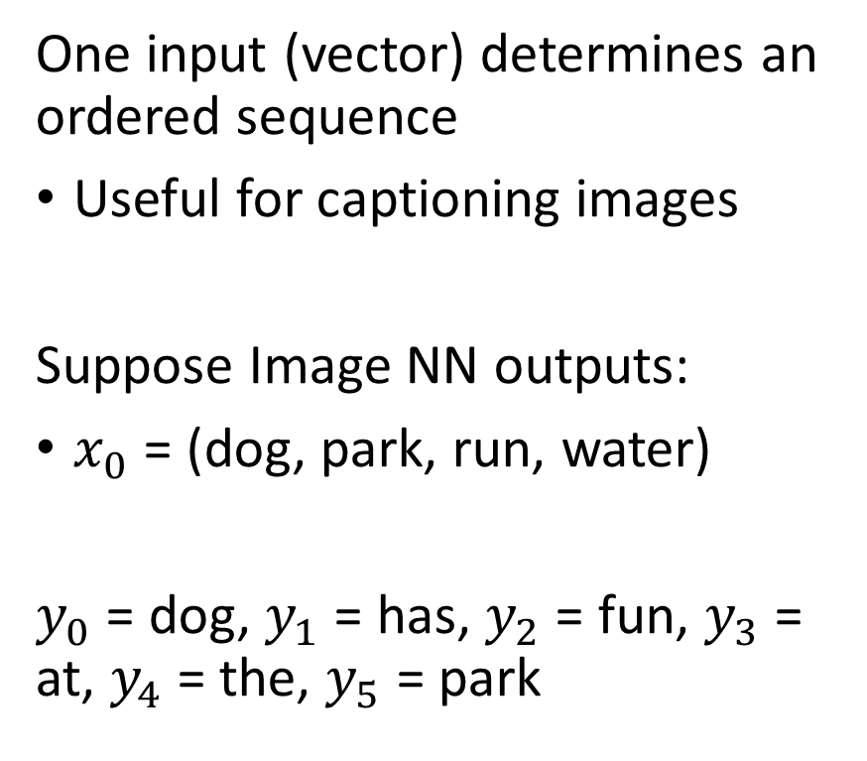
Vector-to-sequence
One input (vector) determines an ordered sequence
Useful for captioning images
Suppose Image NN outputs:
$x_{0}$ = (dog, park, run, water)
$y_{0}$ = dog, $y_{1}$ = has, $y_{2}$ = fun, $y_{3}$ = at, $y_{4}$ = the, $y_{5}$ = park

Slide 17
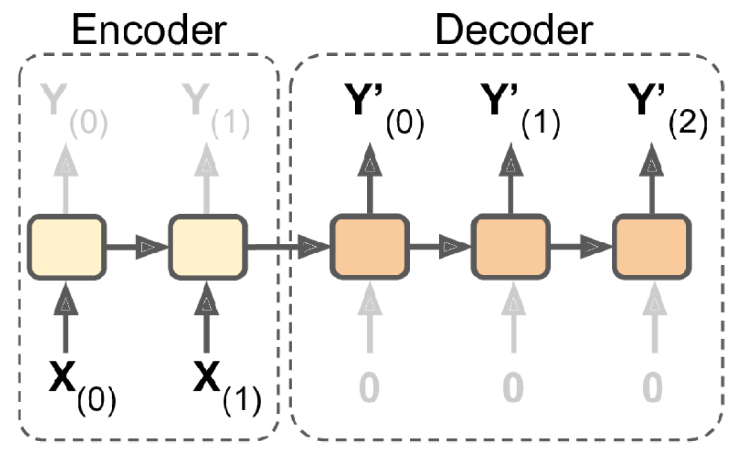
Vector-to-vector: Encoder-decoder
Fully digest the input vector before making a prediction
Useful for translating a sentence in one language to another
Need to understand the “meaning” before translation can begin

Slide 18
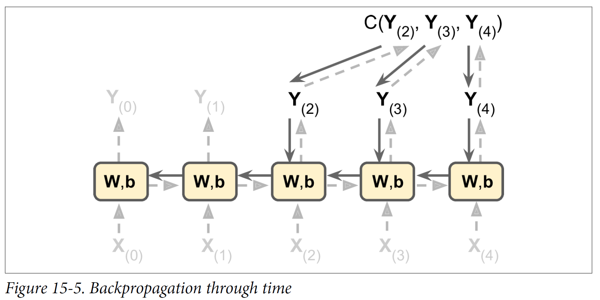
RNN back propagation (BPTT) is similar to ANN
This is one iteration

Slide 19
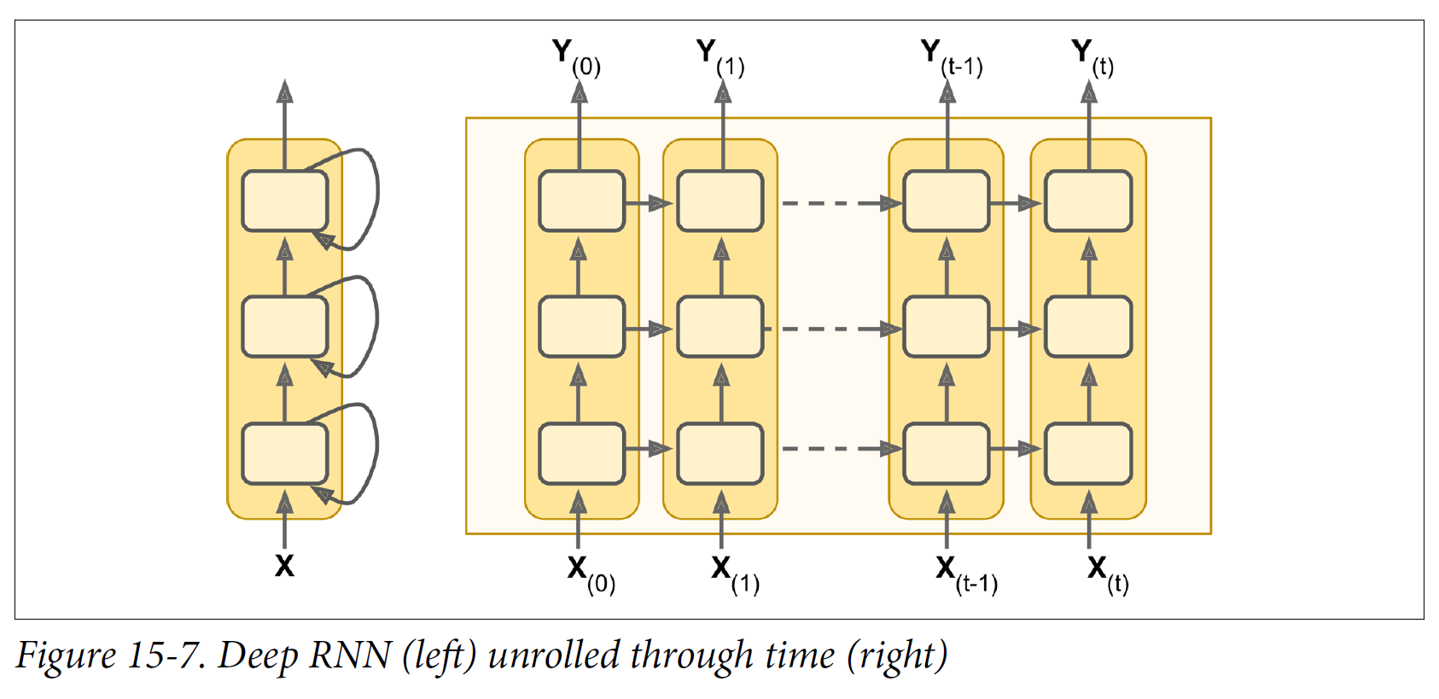
Surprise, RNNs can be deep too!

Slide 20
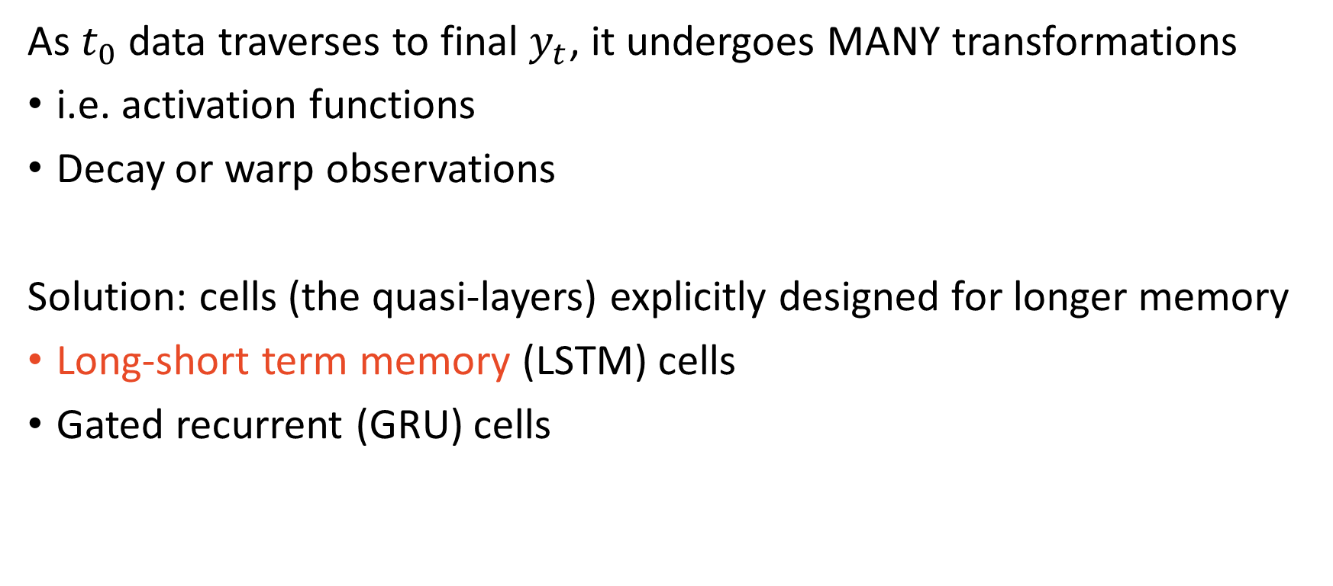
Many transformations cause memory problems
As $t_{0}$ data traverses to final $y_{t}$, it undergoes MANY transformations
i.e. activation functions
Decay or warp observations
Solution: cells (the quasi-layers) explicitly designed for longer memory
Long-short term memory (LSTM) cells
Gated recurrent (GRU) cells

Slide 21
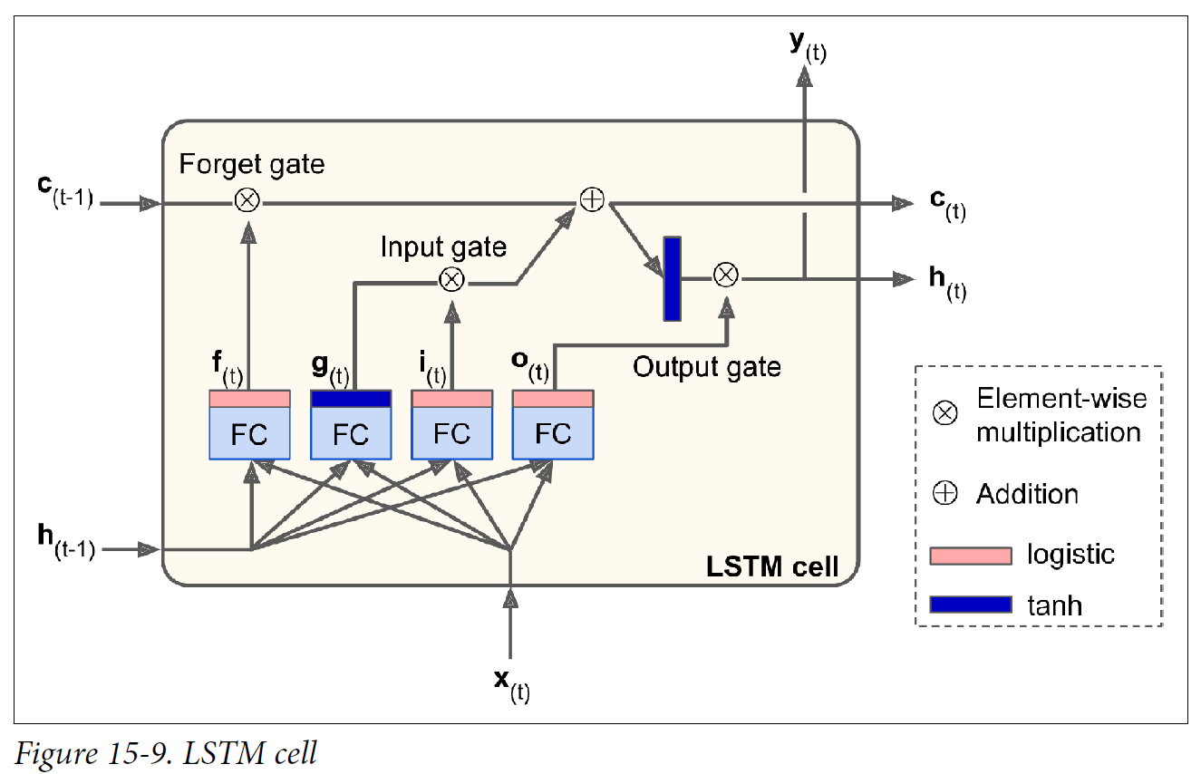
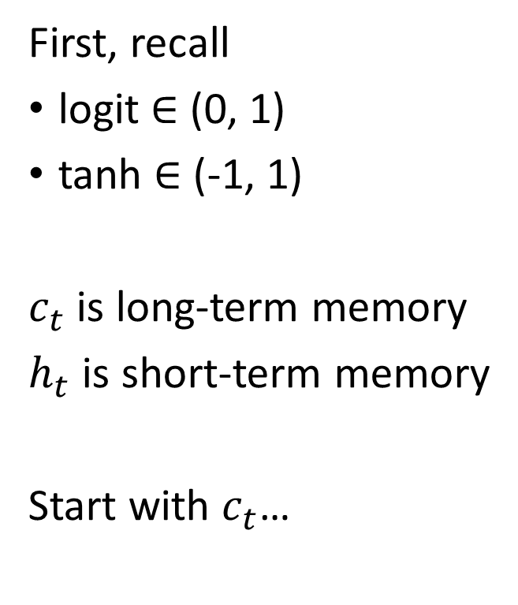
LSTM cells are involved, but understandable
First, recall
logit $∈$ (0, 1)
tanh $∈$ (-1, 1)
$c_{t}$ is long-term memory
$h_{t}$ is short-term memory
Start with $c_{t}$…

Slide 22
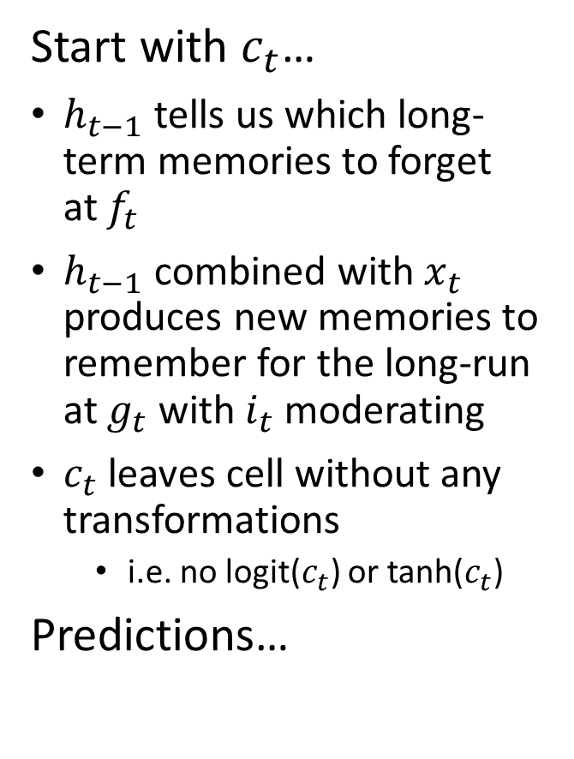
LSTM cells are involved, but understandable
Start with $c_{t}$…
$h_{t−1}$ tells us which long-term memories to forget at $f_{t}$
$h_{t−1}$ combined with $x_{t}$ produces new memories to remember for the long-run at $g_{t}$ with $i_{t}$ moderating
$c_{t}$ leaves cell without any transformations
i.e. no logit($c_{t}$) or tanh($c_{t}$)
Predictions…

Slide 23
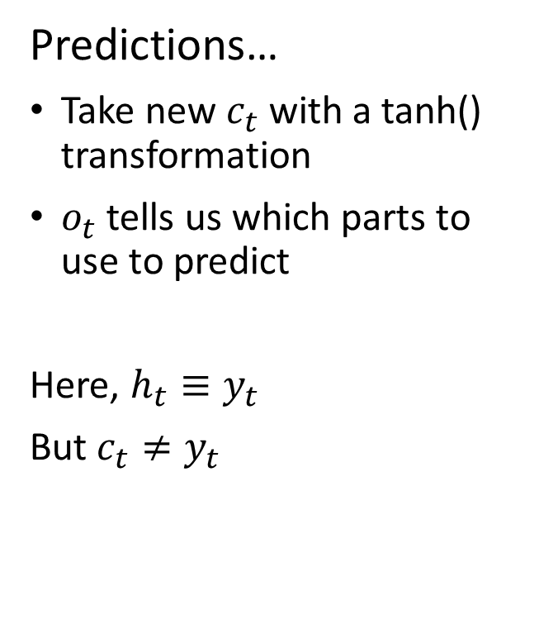
LSTM cells are involved, but understandable
Predictions…
Take new $c_{t}$ with a tanh() transformation
$o_{t}$ tells us which parts to use to predict
Here, $h_{t}≡y_{t}$
But $c_{t}≠y_{t}$

Slide 24
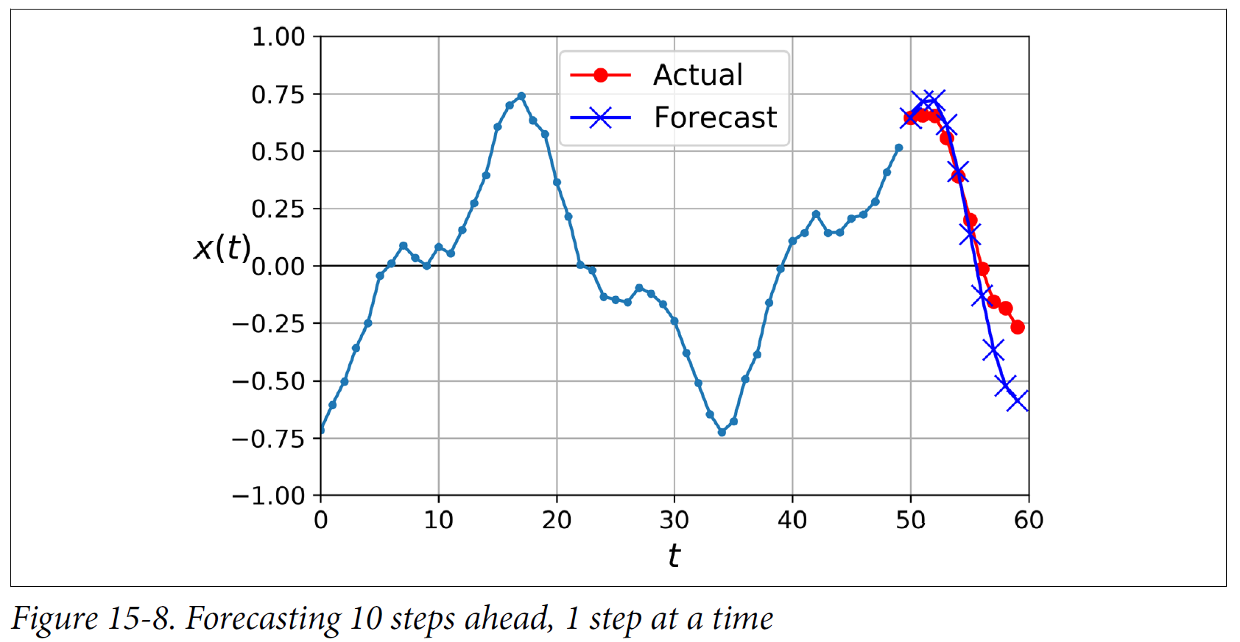
RNN can predict multiple time periods ahead

Slide 25
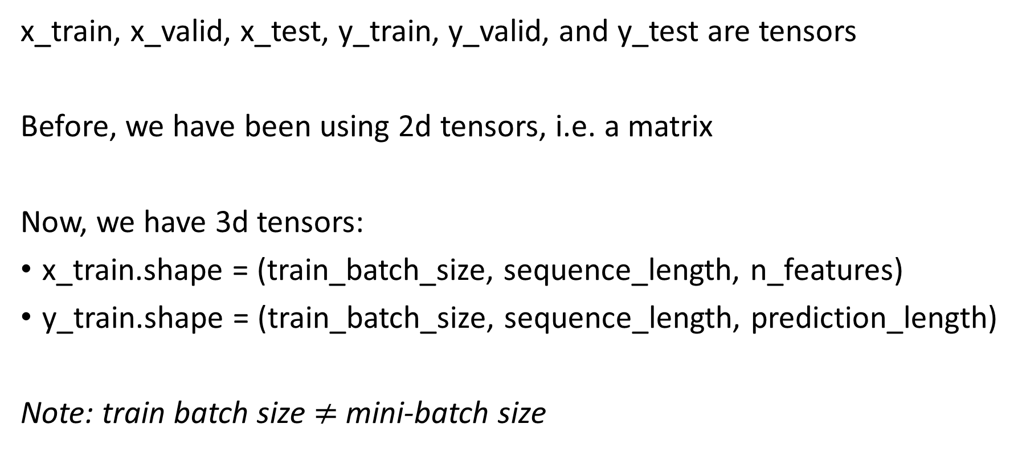
Preparing time series data for NN
x_train, x_valid, x_test, y_train, y_valid, and y_test are tensors
Before, we have been using 2d tensors, i.e. a matrix
Now, we have 3d tensors:
x_train.shape = (train_batch_size, sequence_length, n_features)
y_train.shape = (train_batch_size, sequence_length, prediction_length)
Note: train batch size $≠$ mini-batch size

Slide 26
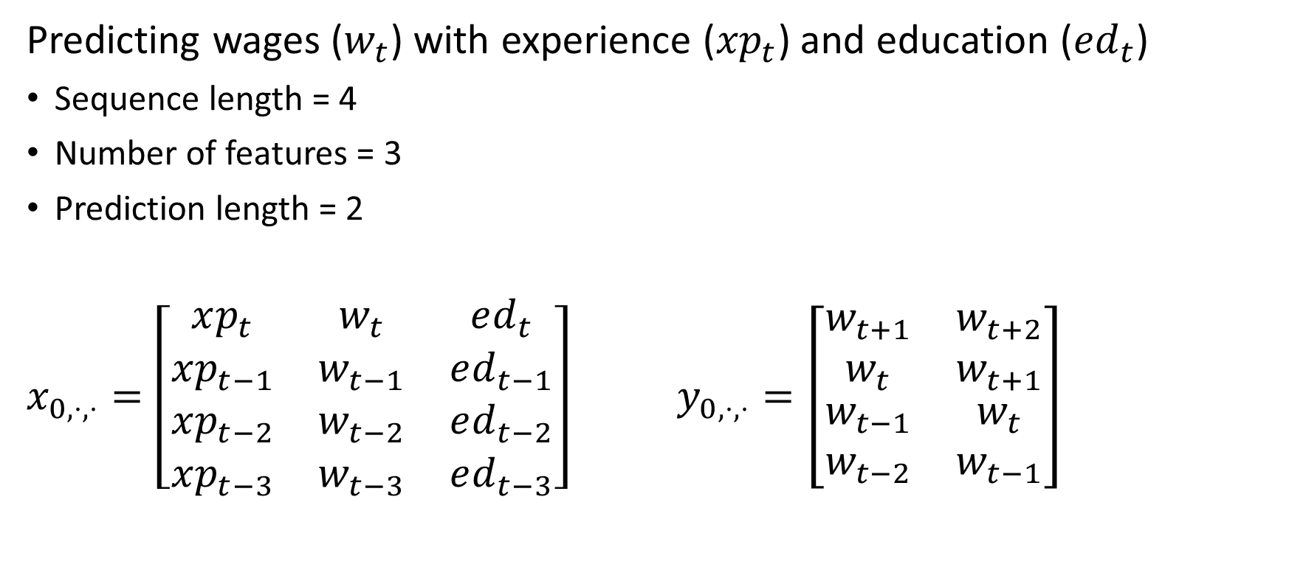
A seq-to-seq example: x_train(0, ., .) & y_train(0,.,.)
Predicting wages ($w_{t}$) with experience (${xp}_{t}$) and education (${ed}_{t}$)
Sequence length = 4
Number of features = 3
Prediction length = 2
$x_{0,⋅,⋅}=\left[\begin{matrix}\begin{matrix}xp_{t} & w_{t} & ed_{t} \\ xp_{t−1} & w_{t−1} & ed_{t−1}\end{matrix} \\ \begin{matrix}xp_{t−2} & w_{t−2} & ed_{t−2} \\ xp_{t−3} & w_{t−3} & ed_{t−3}\end{matrix}\end{matrix}\right]$ $y_{0,⋅,⋅}=\left[\begin{matrix}\begin{matrix}w_{t+1} & w_{t+2} \\ w_{t} & w_{t+1}\end{matrix} \\ \begin{matrix}w_{t−1} & w_{t} \\ w_{t−2} & w_{t−1}\end{matrix}\end{matrix}\right]$

Slide 27
Sequence observations in the batch may overlap
First sequence: [0 2 4 6 8 10 12 14 16 18]
Second sequence: [3 5 7 9 11 13 15 17 19 21]
Third sequence: [6 8 10 12 14 16 18 20 22 24]
...
Last sequence: [78 80 82 84 86 88 90 92 94 96]
Example from Keras
0 | 1 | 2 | … | 99
train
test

Slide 28
Convolution Neural Networks
Finding correlations among features by proximity
A quick overview to describe their use in time series data

Slide 29
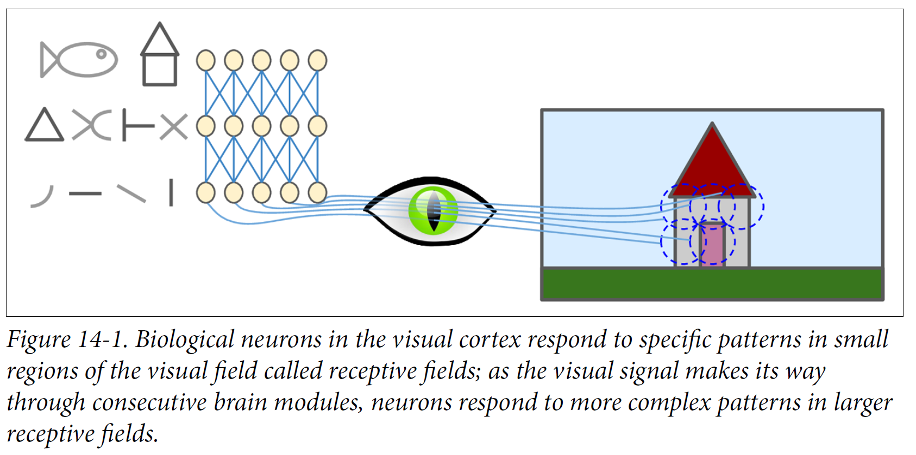
We classify images by pattern recognition

Slide 30
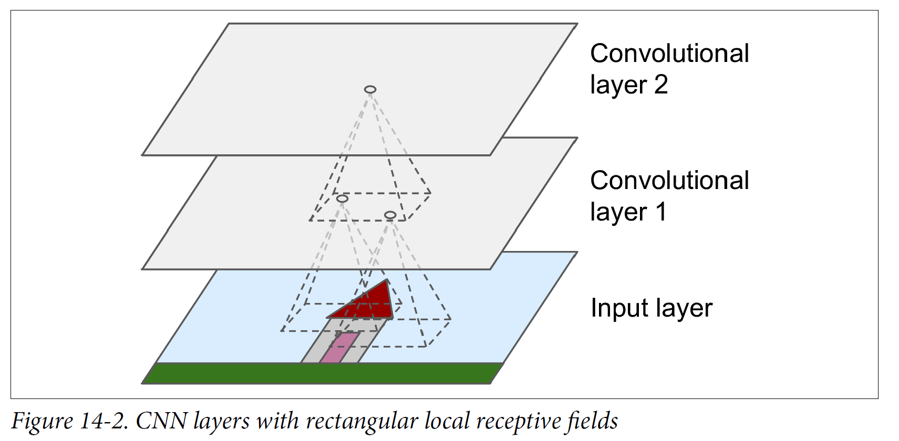
CNN try to replicate us – Here are 2d convolutions

Slide 31
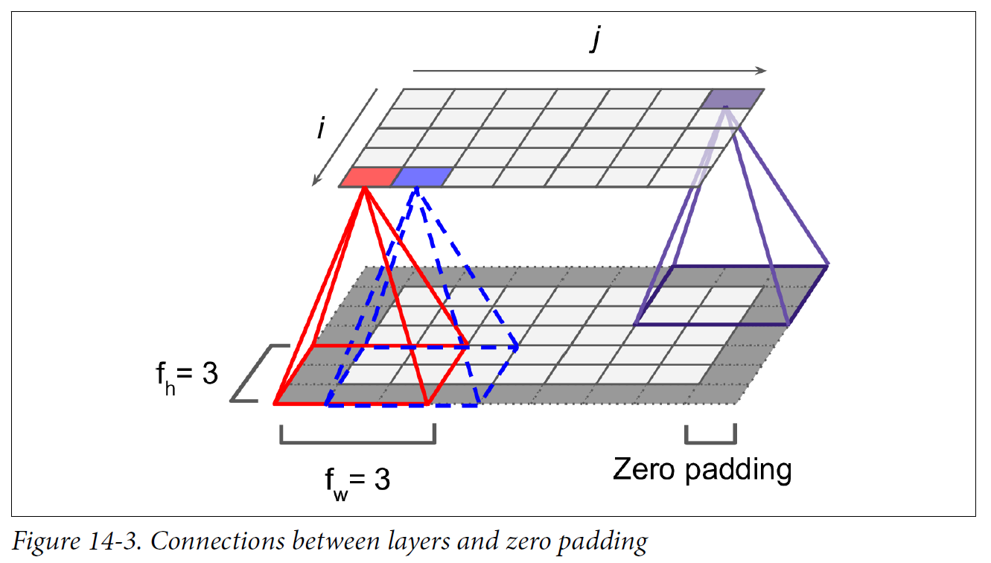
CNN features have specific relative locations

Slide 32
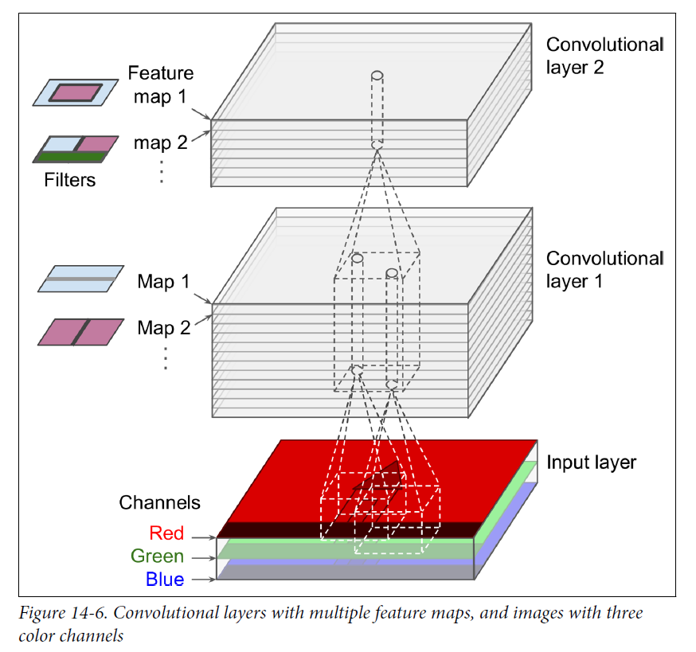
Pixels have three dimensions $⟹$ 3d convolutions

Slide 33
For more on CNN for images
Read HoML Chapter 14
Replicate the chapter 14 code from GitHub (don’t just copy and paste)
Here are some papers using CNNs
Measuring social, environmental and health inequalities using deep learning and street imagery
Using convolutional networks and satellite imagery to identify patterns in urban environments at a large scale

Slide 34
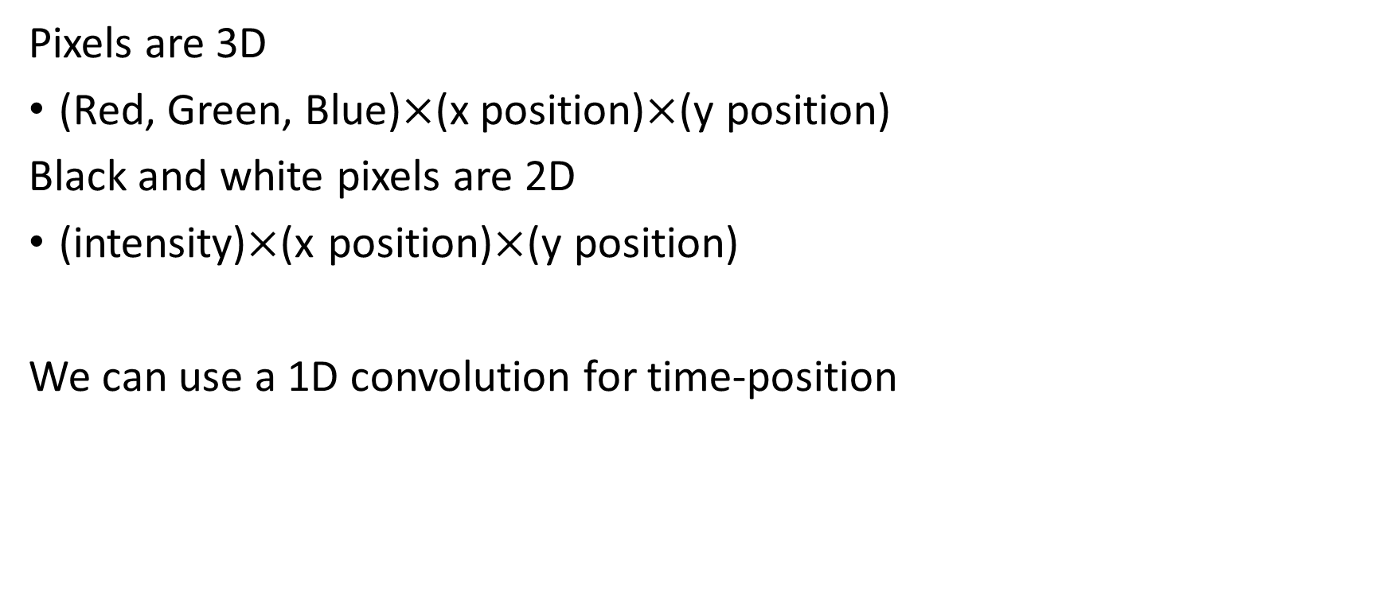
CNN require an ordering to the features
Pixels are 3D
(Red, Green, Blue)$×$(x position)$×$(y position)
Black and white pixels are 2D
(intensity)$×$(x position)$×$(y position)
We can use a 1D convolution for time-position

Slide 35
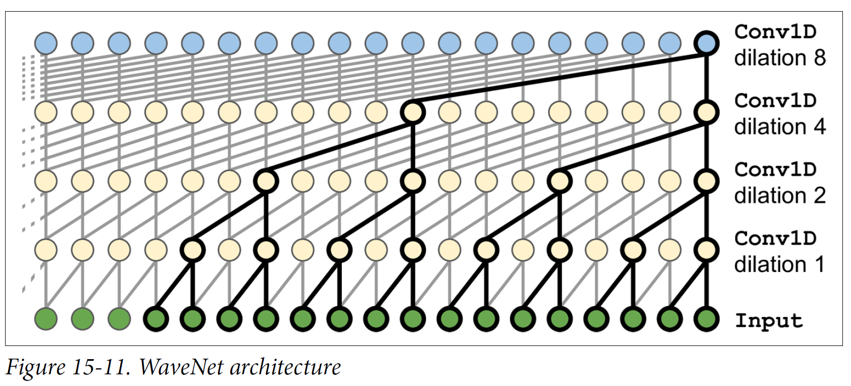
WaveNet is a CNN for time series data

Slide 36
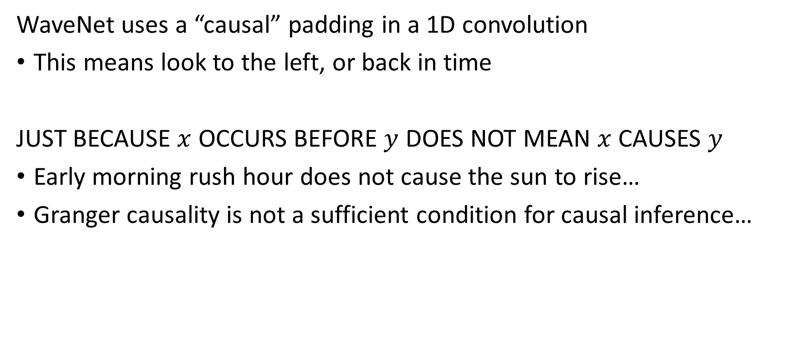
A word of caution with WaveNet
WaveNet uses a “causal” padding in a 1D convolution
This means look to the left, or back in time
JUST BECAUSE $x$ OCCURS BEFORE $y$ DOES NOT MEAN $x$ CAUSES $y$
Early morning rush hour does not cause the sun to rise…
Granger causality is not a sufficient condition for causal inference…

Slide 37
Economic Time Series
Infrequent observations
Context changes

Slide 38
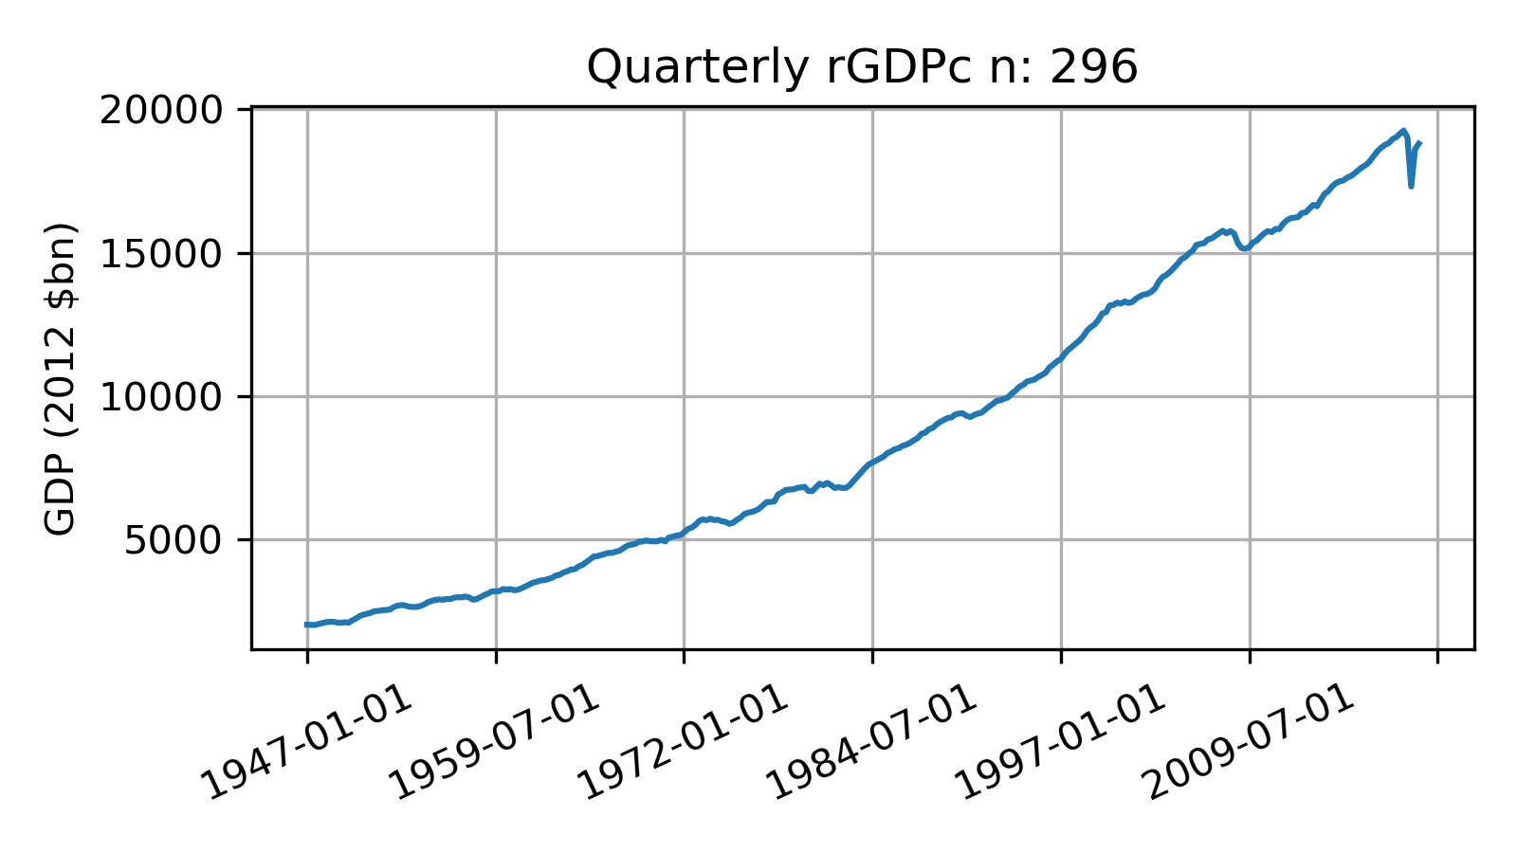
Long economic series have few observations

Slide 39
More frequent observations still not enough

Slide 40
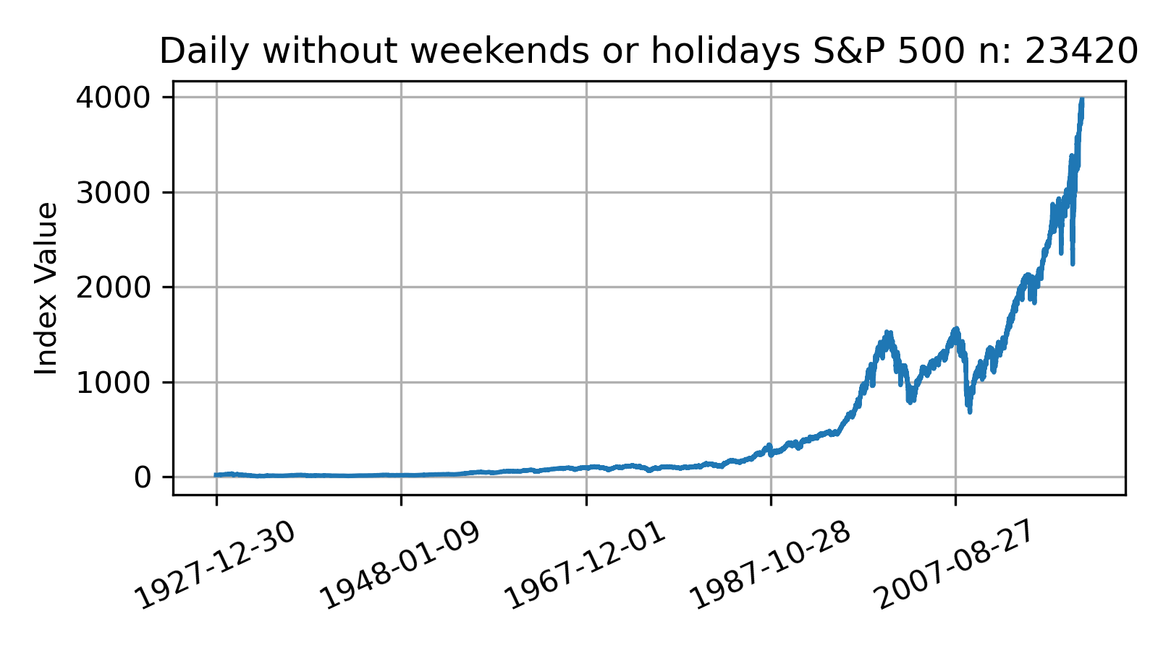
Try financial time series data, not great $n$

Slide 41
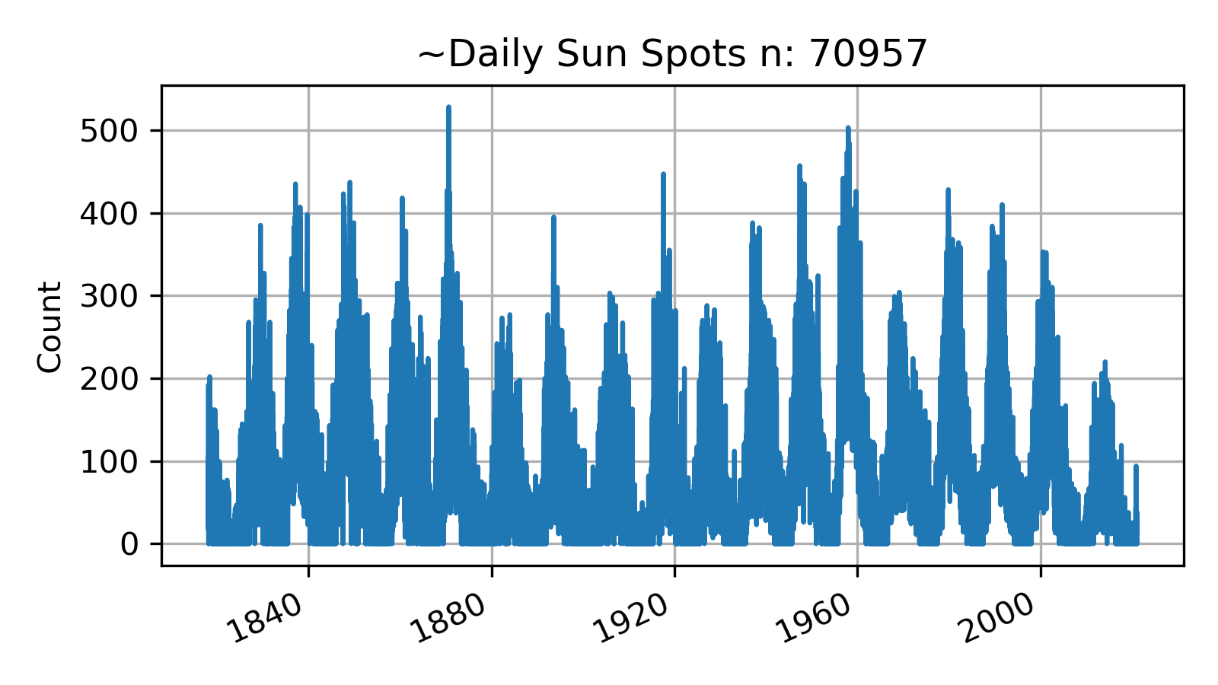
Try longer daily time series, not past 100k threshold

Slide 42
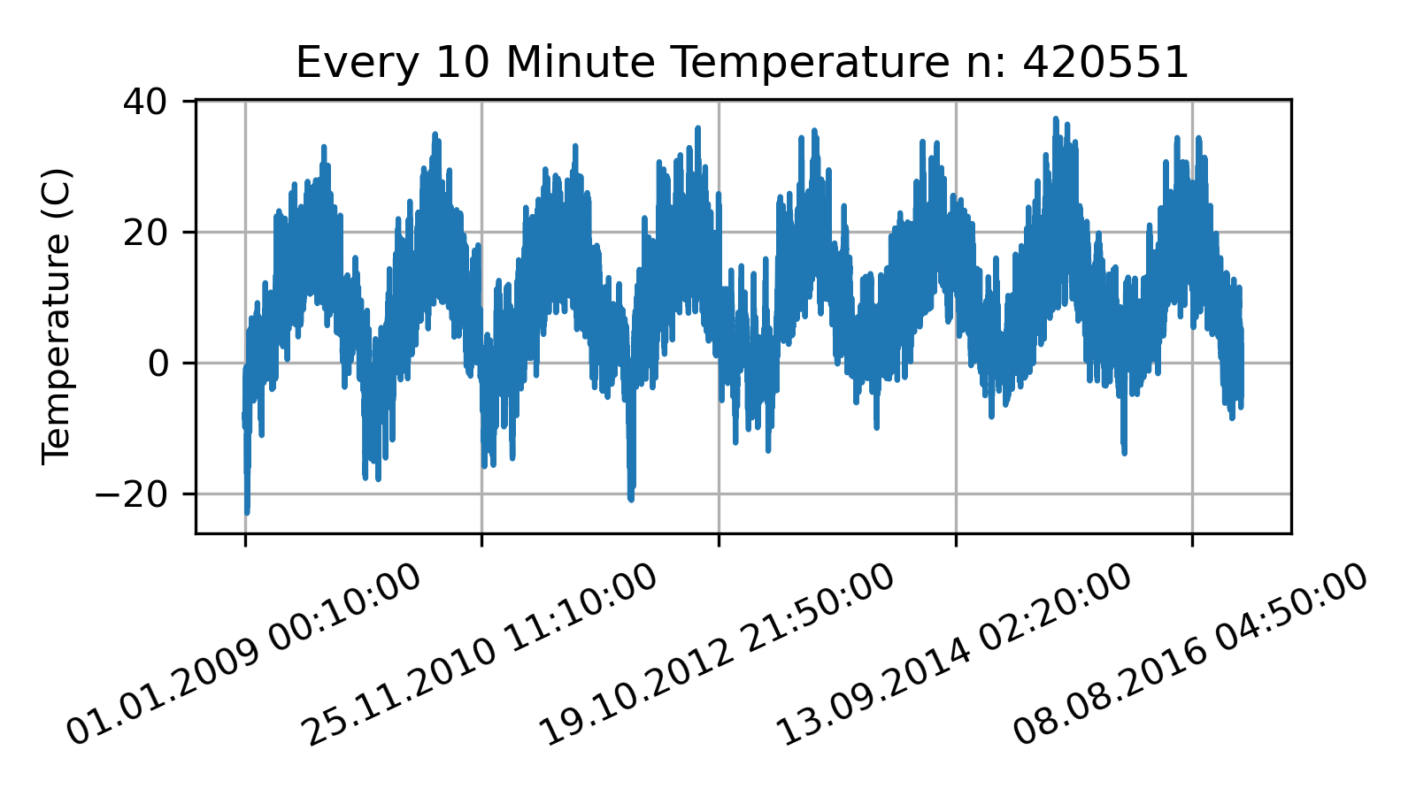
You need higher frequency data for good $n$

Slide 43
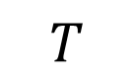
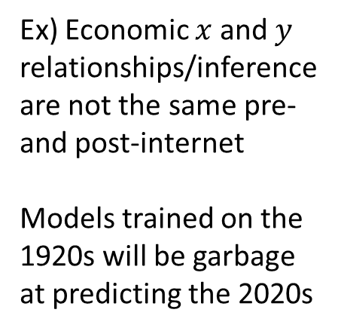
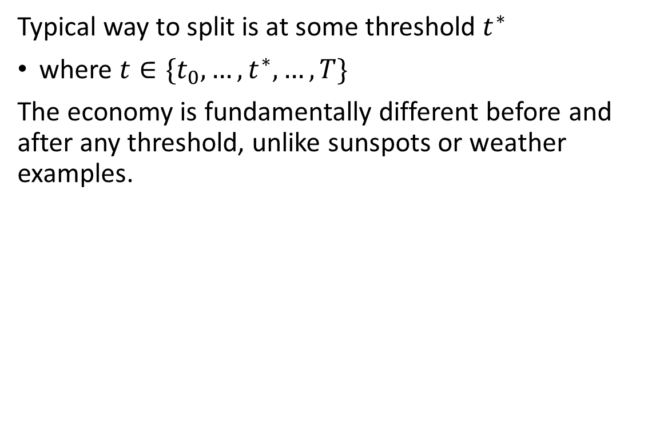
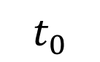
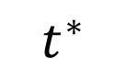
The economy fundamentally changes over time
$$t_{0}$$
Typical way to split is at some threshold $t^{∗}$
where $t∈\{t_{0},…,t^{∗},…,T\}$
The economy is fundamentally different before and after any threshold, unlike sunspots or weather examples.
train
Ex) Economic $x$ and $y$ relationships/inference are not the same pre- and post-internet
Models trained on the 1920s will be garbage at predicting the 2020s
$$t^{∗}$$
test
$$T$$

Slide 44
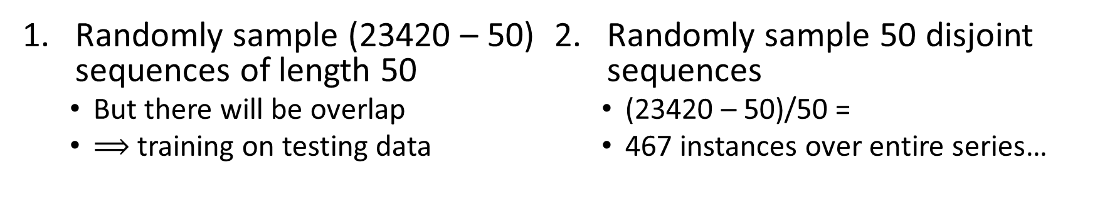
Resolution attempts for S&P 500 data ($n=23420$)
Suppose the sequence length = 50
Randomly sample (23420 – 50) sequences of length 50
But there will be overlap
$⟹$ training on testing data
Randomly sample 50 disjoint sequences
(23420 – 50)/50 =
467 instances over entire series…

Slide 45
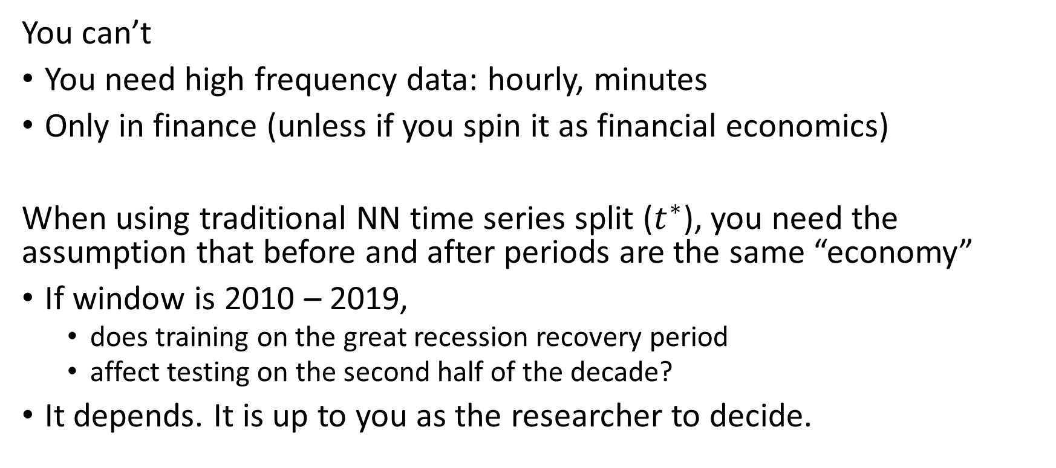
When can we use NN for economic time series
You can’t
You need high frequency data: hourly, minutes
Only in finance (unless if you spin it as financial economics)
When using traditional NN time series split ($t^{∗}$), you need the assumption that before and after periods are the same “economy”
If window is 2010 – 2019,
does training on the great recession recovery period
affect testing on the second half of the decade?
It depends. It is up to you as the researcher to decide.

Slide 46
Neural Networks in Conclusion
Neural networks are data hungry
100k+ observations
NN have limited applications for prediction in economics because of data requirements
Non-economists (and a very small few economists) have been using CNNs on images for predicting economic outcomes
For NN to grow in our field, need to convince economists why NN help determine policy
I don’t have the answer
Artificial Intelligence, Algorithmic Pricing, and Collusion

